Slide 1
Fitting models to experiments
Optical Tweezers Summer School
Santiago, Chile
11.-15. December 2024
Are Mjaavatten

Slide 2
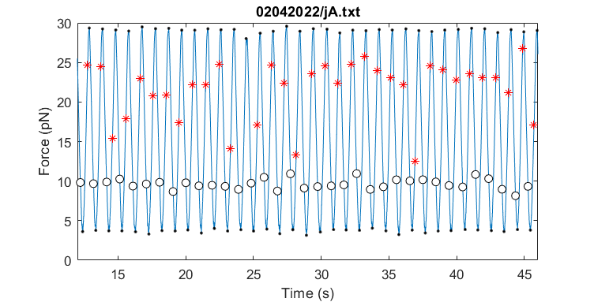
Rip force is not the same for all experiments

Slide 3
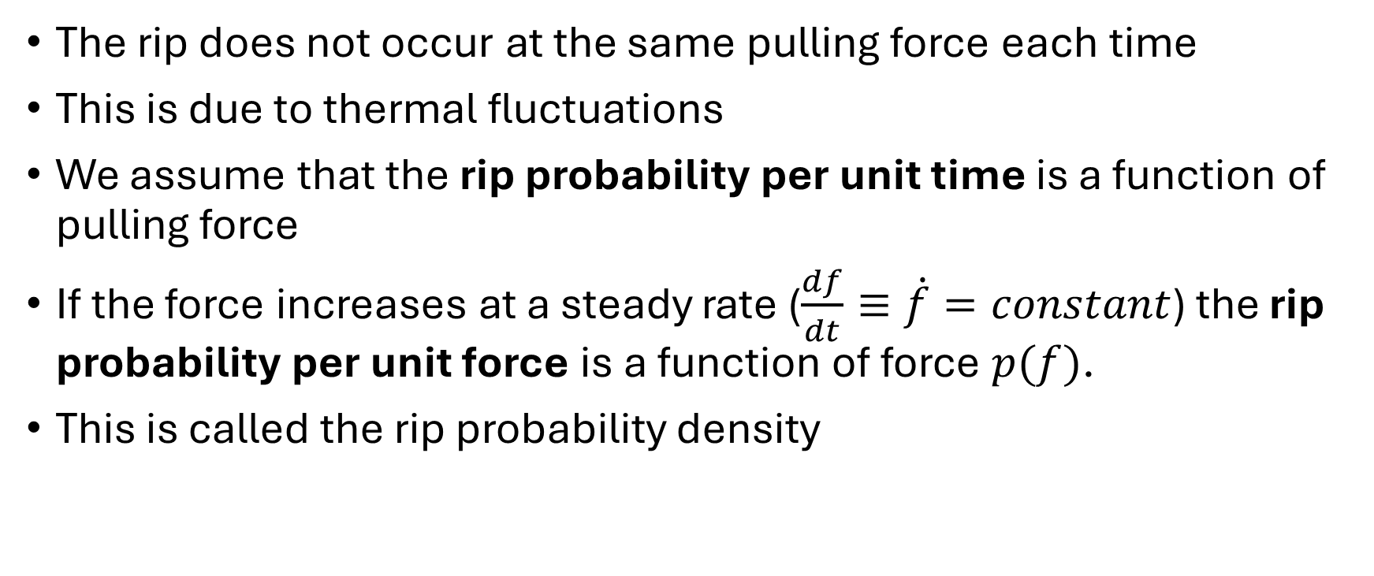
Rip and zip probability
The rip does not occur at the same pulling force each time
This is due to thermal fluctuations
We assume that the rip probability per unit time is a function of pulling force
If the force increases at a steady rate ($\frac{df}{dt}≡\dot{f}=constant$) the rip probability per unit force is a function of force $p(f)$.
This is called the rip probability density

Slide 4
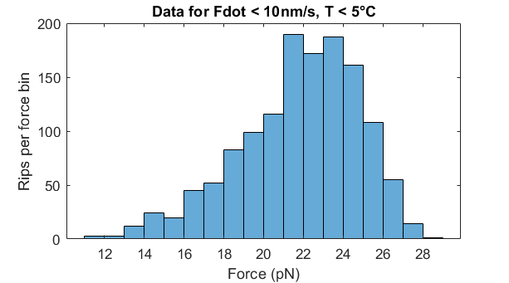
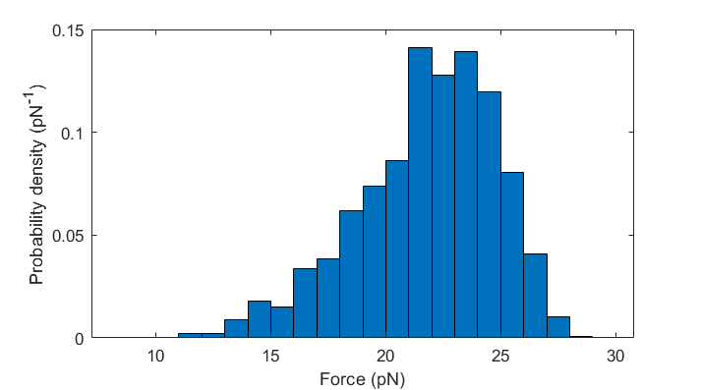
Experimental rip/zip probability estimates per unit force
If we have recorded the rip force for many events with similar parameters, we can count the number of rips inside force intervals (force bins) and create a histogram.
Dividing the number in each bin by the total we get an estimate of the probability density
The models take this density as input

Slide 5
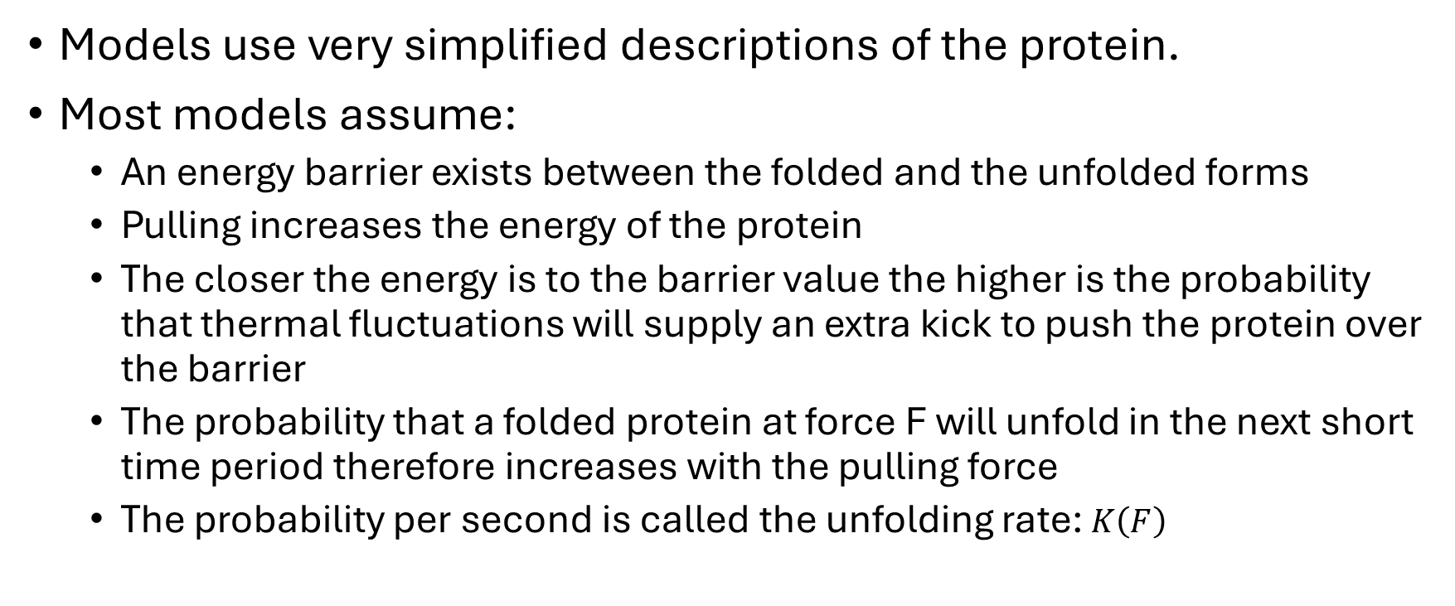
Modelling of protein unfolding
Models use very simplified descriptions of the protein.
Most models assume:
An energy barrier exists between the folded and the unfolded forms
Pulling increases the energy of the protein
The closer the energy is to the barrier value the higher is the probability that thermal fluctuations will supply an extra kick to push the protein over the barrier
The probability that a folded protein at force F will unfold in the next short time period therefore increases with the pulling force
The probability per second is called the unfolding rate: $K\left(F\right)$

Slide 6
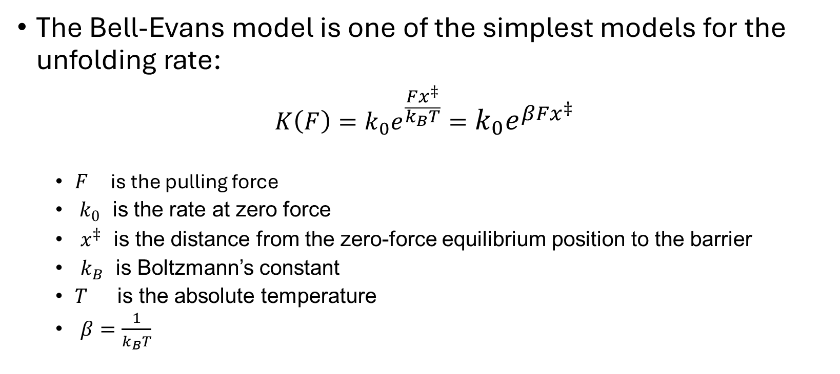
Bell-Evans model
The Bell-Evans model is one of the simplest models for the unfolding rate:
$$K\left(F\right)=k_{0}e^{\frac{Fx^{‡}}{k_{B}T}}=k_{0}e^{βFx^{‡}}$$
$F$ is the pulling force
$k_{0}$ is the rate at zero force
$x^{‡}$ is the distance from the zero-force equilibrium position to the barrier
$k_{B}$ is Boltzmann’s constant
$T$ is the absolute temperature
$β=\frac{1}{k_{B}T}$
Evans & Ritchie, Biophys J. 72 (1997)

Slide 7
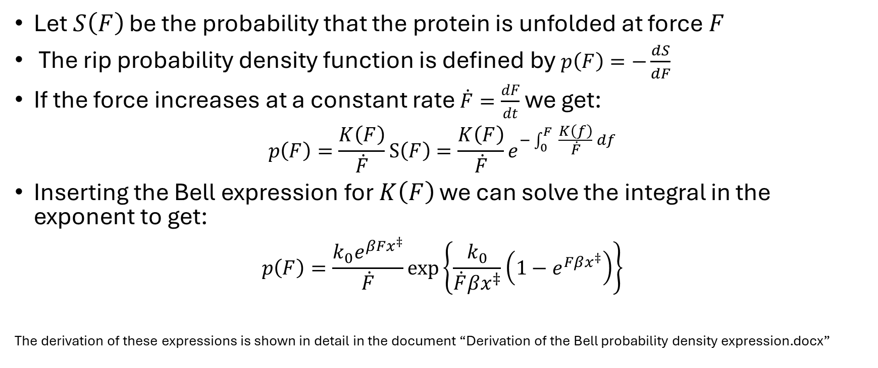
Rip probability density function
Let $S\left(F\right)$ be the probability that the protein is unfolded at force $F$
The rip probability density function is defined by $p\left(F\right)=−\frac{dS}{dF}$
If the force increases at a constant rate $\dot{F}=\frac{dF}{dt}$ we get:
$$p\left(F\right)=\frac{K\left(F\right)}{\dot{F}}S\left(F\right)=\frac{K\left(F\right)}{\dot{F}}e^{−\int_{0}^{F}{ \frac{K\left(f\right)}{\dot{F}} df}}$$
Inserting the Bell expression for $K\left(F\right)$ we can solve the integral in the exponent to get:
$$p\left(F\right)=\frac{k_{0}e^{βFx^{‡}}}{\dot{F}}exp\left\{\frac{k_{0}}{\dot{F}βx^{‡}}\left(1−e^{Fβx^{‡}}\right)\right\}$$
The derivation of these expressions is shown in detail in the document “Derivation of the Bell probability density expression.docx”

Slide 8
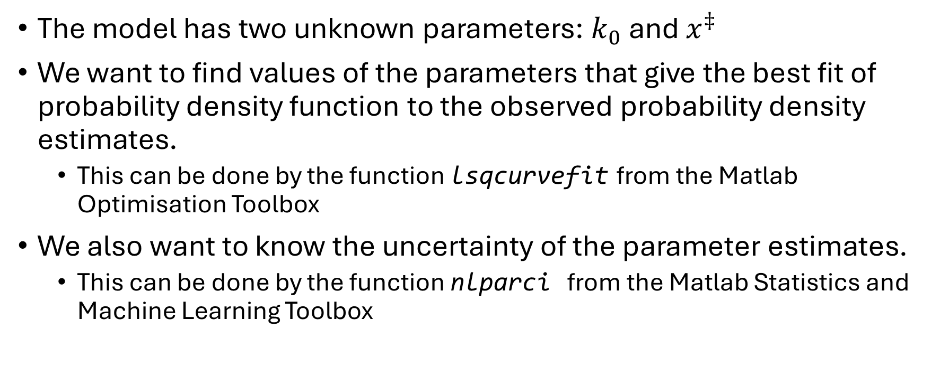
Fitting the Bell-Evans model to experiments
The model has two unknown parameters: $k_{0}$ and $x^{‡}$
We want to find values of the parameters that give the best fit of probability density function to the observed probability density estimates.
This can be done by the function lsqcurvefit from the Matlab Optimisation Toolbox
We also want to know the uncertainty of the parameter estimates.
This can be done by the function nlparci from the Matlab Statistics and Machine Learning Toolbox
lsqcurvefit: Solve nonlinear curve-fitting (data-fitting) problems in the least-squares sense
nlparci: Nonlinear regression parameter confidence intervals

Slide 9
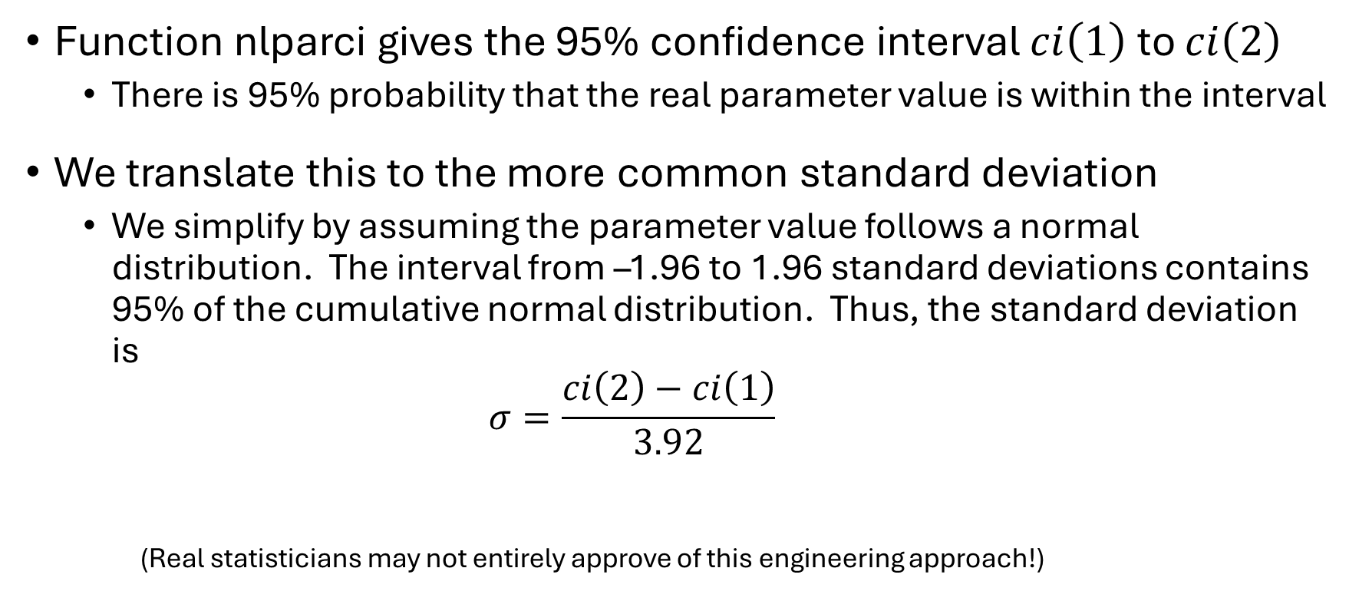
Confidence interval and standard deviation
Function nlparci gives the 95% confidence interval $ci\left(1\right)$ to $ci\left(2\right)$
There is 95% probability that the real parameter value is within the interval
We translate this to the more common standard deviation
We simplify by assuming the parameter value follows a normal distribution. The interval from –1.96 to 1.96 standard deviations contains 95% of the cumulative normal distribution. Thus, the standard deviation is $σ=\frac{ci\left(2\right)−ci\left(1\right)}{3.92}$
(Real statisticians may not entirely approve of this engineering approach!)

Slide 10
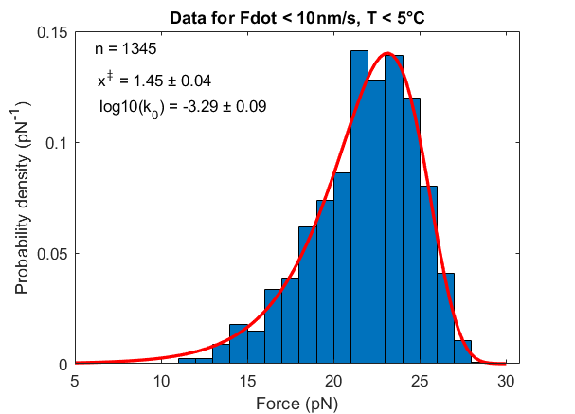
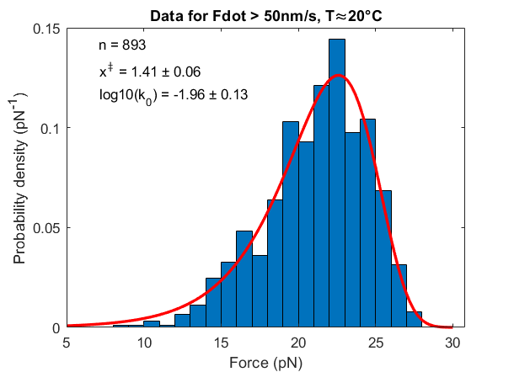
Fitting results
Data for 3588 rip events from 32 experiments on the protein MJ0366.
Ref: Rivera, Mjaavatten, Smith, Baez, & Wilson (2023). Biophysical Journal, 122(3), 513-521.

Slide 11
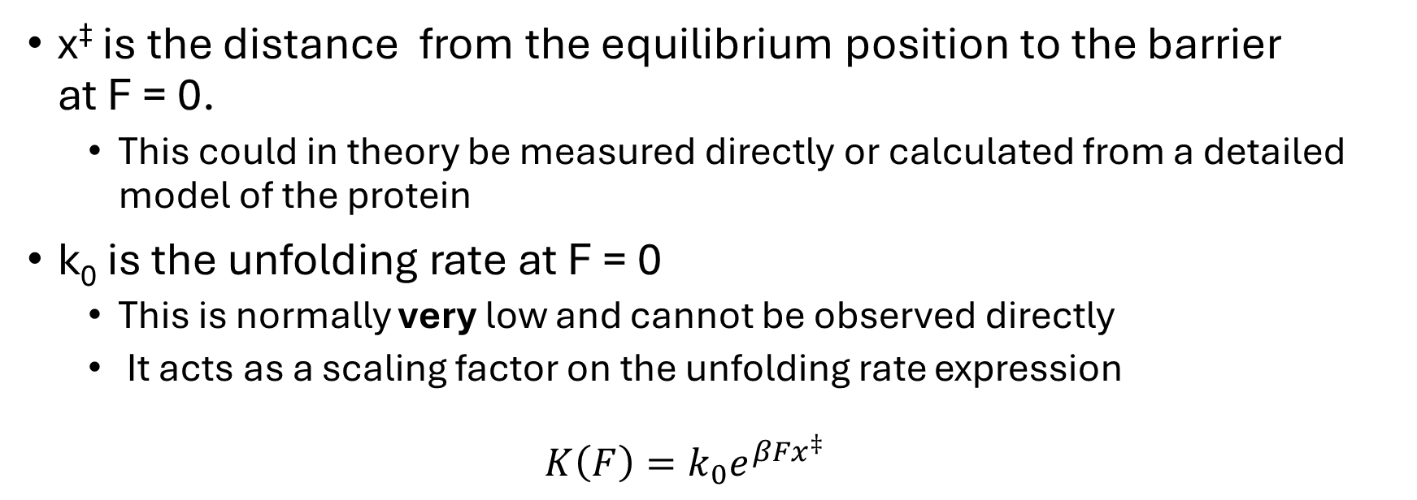
What do the parameters mean?
x‡ is the distance from the equilibrium position to the barrier at F = 0.
This could in theory be measured directly or calculated from a detailed model of the protein
k₀ is the unfolding rate at F = 0
This is normally very low and cannot be observed directly
It acts as a scaling factor on the unfolding rate expression
$$K\left(F\right)=k_{0}e^{βFx^{‡}}$$
Protein pulling experiments are a simple(?) way of observing these properties

Slide 12
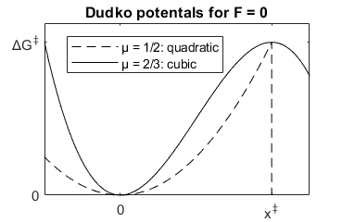
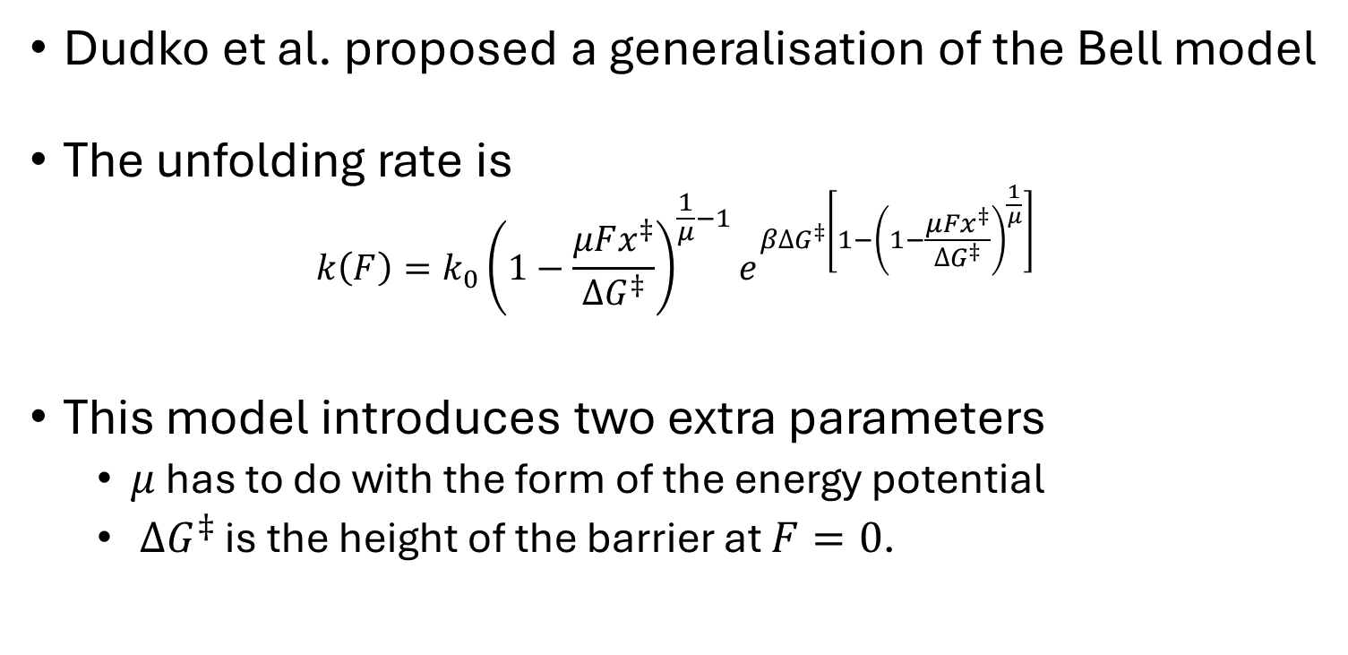
The Dudko model
Dudko et al. proposed a generalisation of the Bell model
The unfolding rate is $k\left(F\right)=k_{0}{\left(1−\frac{μFx^{‡}}{∆G^{‡}}\right)}^{\frac{1}{μ}−1}e^{β∆G^{‡}\left[1−{\left(1−\frac{μFx^{‡}}{∆G^{‡}}\right)}^{\frac{1}{μ}}\right]}$
This model introduces two extra parameters
$μ$ has to do with the form of the energy potential
$∆G^{‡}$ is the height of the barrier at $F=0$.
Dudko, Hammer and Szabo (Phys. Rev. Lett. 96. 2006)

Slide 13
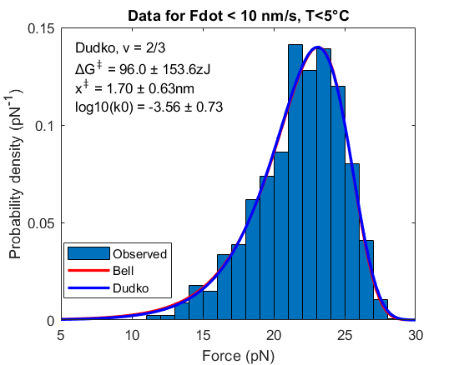
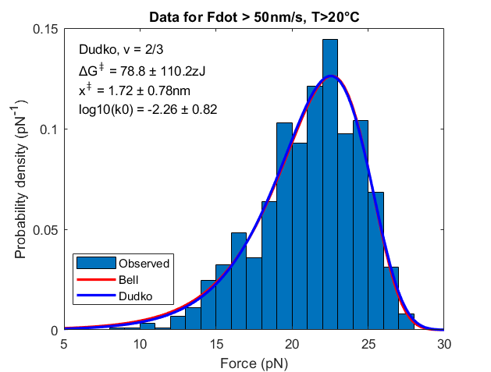
In this case the two models are equally good

Slide 14
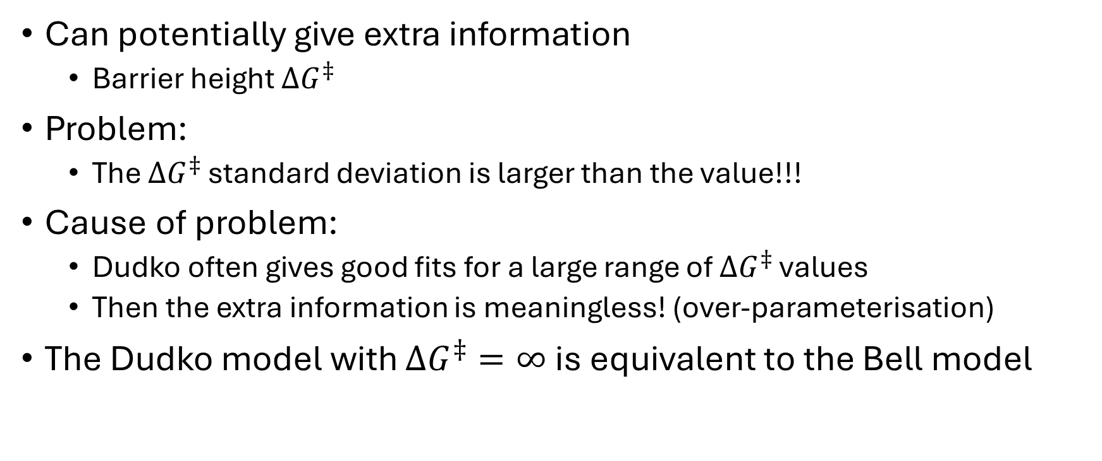
Why use the Dudko model?
Can potentially give extra information
Barrier height $∆G^{‡}$
Problem:
The $∆G^{‡}$ standard deviation is larger than the value!!!
Cause of problem:
Dudko often gives good fits for a large range of $∆G^{‡}$ values
Then the extra information is meaningless! (over-parameterisation)
The Dudko model with $∆G^{‡}=∞$ is equivalent to the Bell model

Slide 15
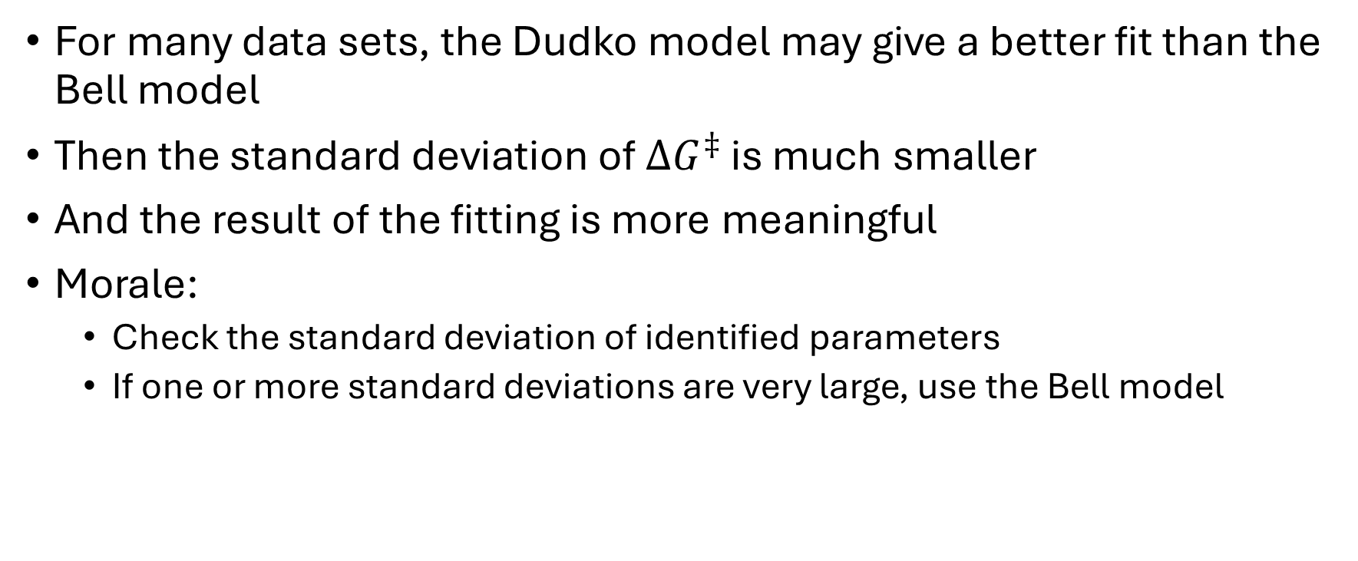
When is the Dudko model relevant?
For many data sets, the Dudko model may give a better fit than the Bell model
Then the standard deviation of $∆G^{‡}$ is much smaller
And the result of the fitting is more meaningful
Morale:
Check the standard deviation of identified parameters
If one or more standard deviations are very large, use the Bell model

Slide 16
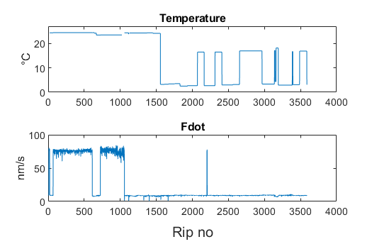
Experimenters may vary the conditions between experiments
It is usually of interest to study how experimental parameters influence the experiment results
The figure shows temperature and pulling speed for a large set of experiment data
Easy to select subsets of tables, to study effect of e.g. temperature
Data for 3588 rip events from 32 experiments on the protein MJ0366.
Ref: Rivera, Mjaavatten, Smith, Baez, & Wilson (2023). Biophysical Journal, 122(3), 513-521.

Slide 17
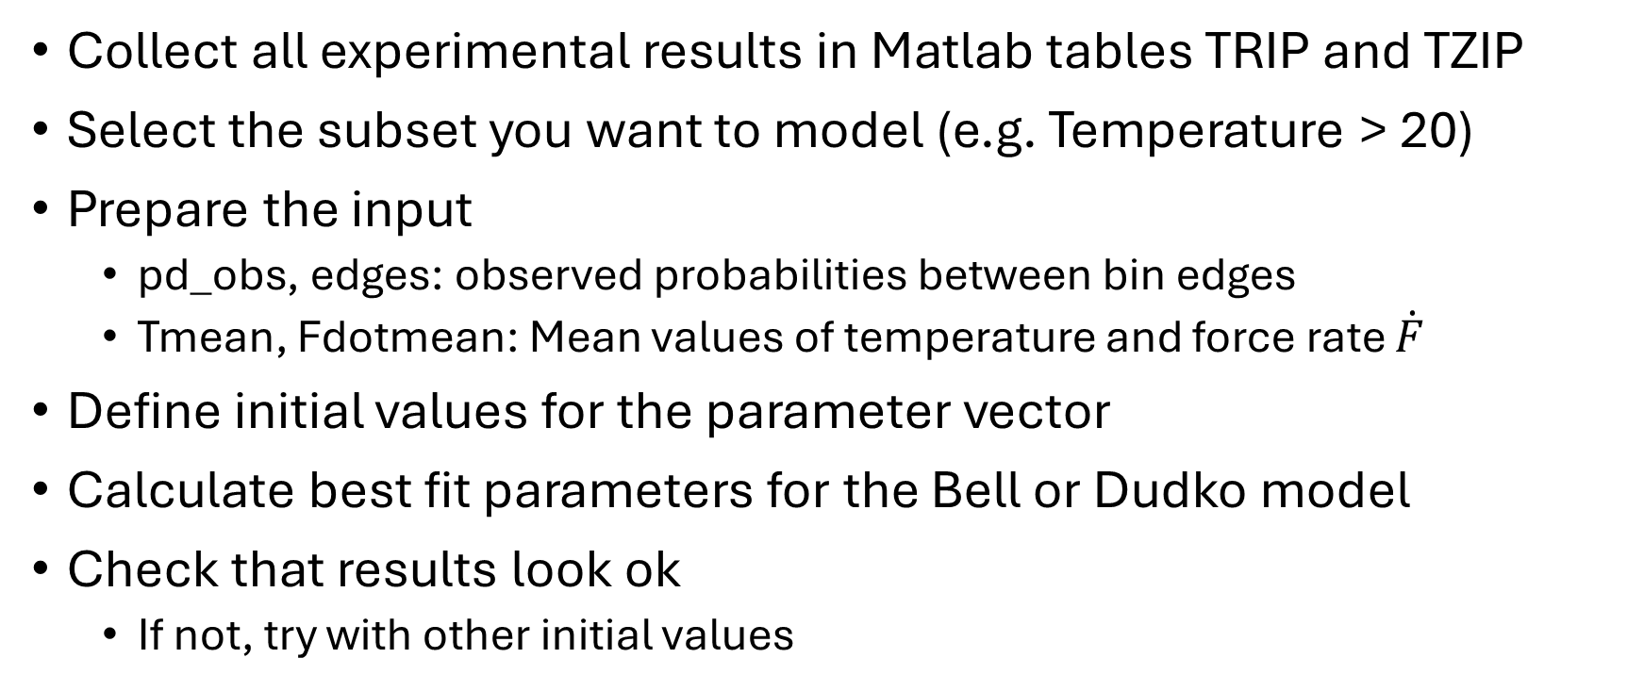
Model fitting workflow
Collect all experimental results in Matlab tables TRIP and TZIP
Select the subset you want to model (e.g. Temperature > 20)
Prepare the input
pd_obs, edges: observed probabilities between bin edges
Tmean, Fdotmean: Mean values of temperature and force rate $\dot{F}$
Define initial values for the parameter vector
Calculate best fit parameters for the Bell or Dudko model
Check that results look ok
If not, try with other initial values

Slide 18
Creating summary tables
Collect all experiment subfolders in a string array:
folders = ["subfolder1","subfolder2","subfolder3"];
Create array of experiment file names:
files = experiment_filenames(folders);
Merge Trip and Tzip tables for all experiment files.
[TRIP,TZIP] = collect_tables(files,outputfolder);
Default outputfolder is the one defined in the app
Reads tables created by the RipAnalysis app where available
For the rest, calculates automatic tables using the analyse_experiment function
collect_tables can also be used without the app

Slide 19
Select subsets
"omitmissing"
"omitmissing"
Use logical arrays to select the data subsets of interest
Example: Experiments with T >20˚C and Pulling speed < 50nm/s ok = TRIP.Temperature>20 & TRIP.Pullingspeed < 50;
ok = 1 where the condition is true, 0 elsewhere
Example of how logical arrays can be used
>> x = [5 3 -2 6 -4 1];
>> y = [1 2 3 4 5 6];
>> positive_x = x>0
positive_x =
1×6 logical array
1 1 0 1 0 1
>> y(positive_x)
ans =
1 2 4 6

Slide 20
Prepare input
Use the logical array ok to extract only the relevant data:
F = TRIP.Force(ok);
Tmean = mean(TRIP.Temperature(ok),"omitmissing");
Fdotmean = mean(TRIP.Fdot(ok),"omitmissing");
Function probdens will calculate the observed probability density array:
dF = 1; % distance between force bin edges
[pd_obs,edges,n_obs] = probdens(force,dF); pd_obs(i) is the observed probability for unfolding (or refolding) in the interval from edges(i) to edges(i+1) divided by edges(i+1)-edges(i)
n_obs is the number of rips or zips

Slide 21
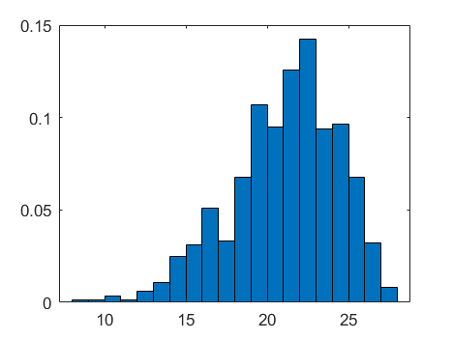
Plot observed probability density
Find mid-points of the force bins
F_list = (edges(1:end-1)+edges(2:end))/2;
Create bar plot with bar width equal the bin width:
figure; bar(F_list,pd_obs,dF);

Slide 22
Initial parameter values
The optimisation function lsqcurvefit tries to find parameter values that minimise the difference between calculated and observe probability densities
The initial parameter vector tells lsqcurvefit where to start the search
Optimisation may be tricky:
The search may easily fail if initial values are far from the solution

Slide 23
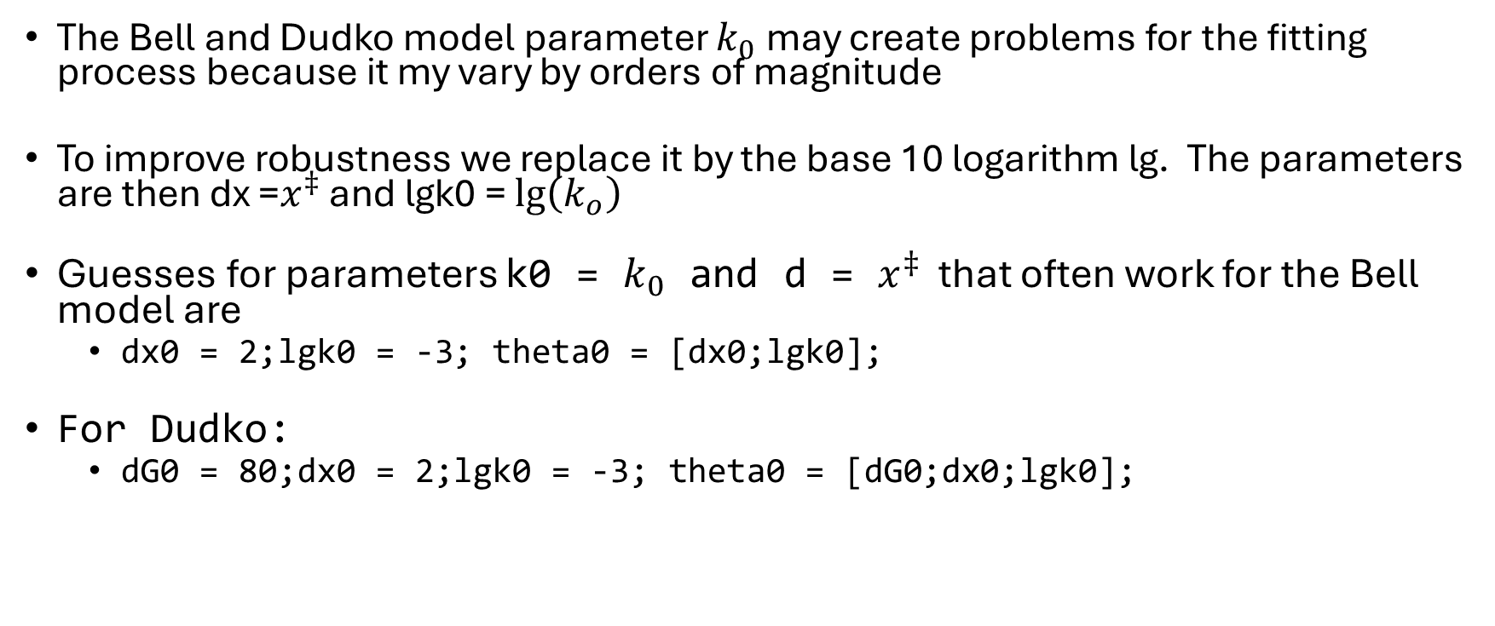
Initial parameter values
The Bell and Dudko model parameter $k_{0}$ may create problems for the fitting process because it my vary by orders of magnitude
To improve robustness we replace it by the base 10 logarithm lg. The parameters are then dx =$x^{‡}$ and lgk0 = $\lg\left(k_{o}\right)$
Guesses for parameters k0 = $k_{0}$ and d = $x^{‡}$ that often work for the Bell model are
dx0 = 2;lgk0 = -3; theta0 = [dx0;lgk0];
For Dudko:
dG0 = 80;dx0 = 2;lgk0 = -3; theta0 = [dG0;dx0;lgk0];

Slide 24
Fitting the Bell model
Function Bell_unfold_probability calculates the probability density distribution for a given parameter vector
Function fit_Bell_unfold calls this function repeatedly, searching for the parameter set that best fits the observed distribution;
[theta,theta_std] = fit_Bell_unfold(pd_obs,edges,Tmean,Fdotmean,theta0);
Print results:
fprintf("x‡ = %.2fnm ± %.2g\n",theta(1),theta_std(1))
fprintf("lg(k0) = %.2f ± %.2g\n",theta(2),theta_std(2))
x‡ = 1.40nm ± 0.068
lg(k0) = -1.92 ± 0.15

Slide 25
Inspecting the result
Create a set of 100 force values for the x axis:
F_plot = linspace(edges(1),edges(end));
Calculate and plot the probability density a:
pd = Bell_unfold_probability(theta,F_plot,Tmean,Fdotmean);
hold on;
plot(F_plot,pd,'r','linewidth',2);
Add info to the plot:
xlabel("Force (pN)")
ylabel("Probability density (pN^-^1)")
title("Probability density for T>20\circC")
legend("Observed","Bell model","location","northwest")
\circ is LaTex for °

Slide 26
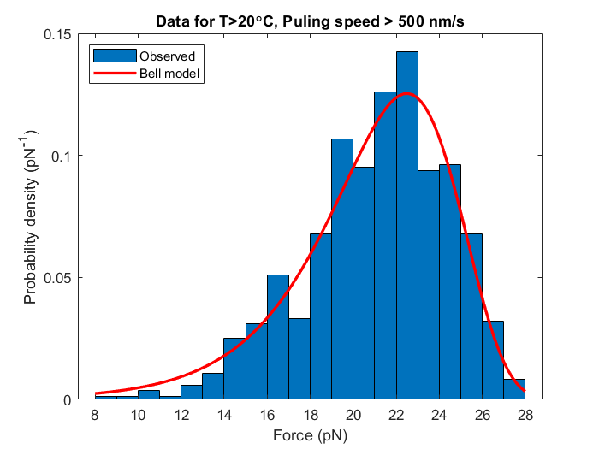
All the Matlab commands in the previous slides are collected in the file model_fitting_demo.m

Slide 27
Units
Optical Tweezers experiments require some special units:
Length: nm = 10⁻⁹m
Force: pN = 10⁻¹²N
Energy per molecule: nm·pN = zJ = 10⁻²¹J
Avogadro constant: N_{A} = 6.02214 ×10²³ molecules/mol
Energy per mol: 1nm·pN · N_{A}= 602.214J/mol = 602.214 (J/mol) / 4184J/kcal = 0.1439 kcal/mol
Boltzmann constant: k_{B} = 1.381 J ×10⁻²³J/K = 0.01381 nm·pN /K

